Slide 1
BRAIN AGE ESTIMATION
By Kathakoli Sengupta

Slide 2
DATA PREPROCESSING
Input List Excel: /projectnb/bucbi/Kathakoli/Input List.xlsx
Input List:
Gulf_war_T1_T2: input_list_gwt1t2
GW_session2: input_List_GW2
GW_Alabama: : input_list_albama
GW_UCSF: input_list_ucsf
GW_Georgetown: input_list_g
ADNI1_CN: inputlistadni1
ADNI2_CN: inputlistadni2
NACC_T1: input_list_NACC
HCP_T1: input_list_HCP
UMass_T1: input_list_UMass
Scripts:
Skull Stripping: script.py
Linear Registration: flirt.py
Binary Mask: mask.py
Ravens Map: ravens.py

Slide 3
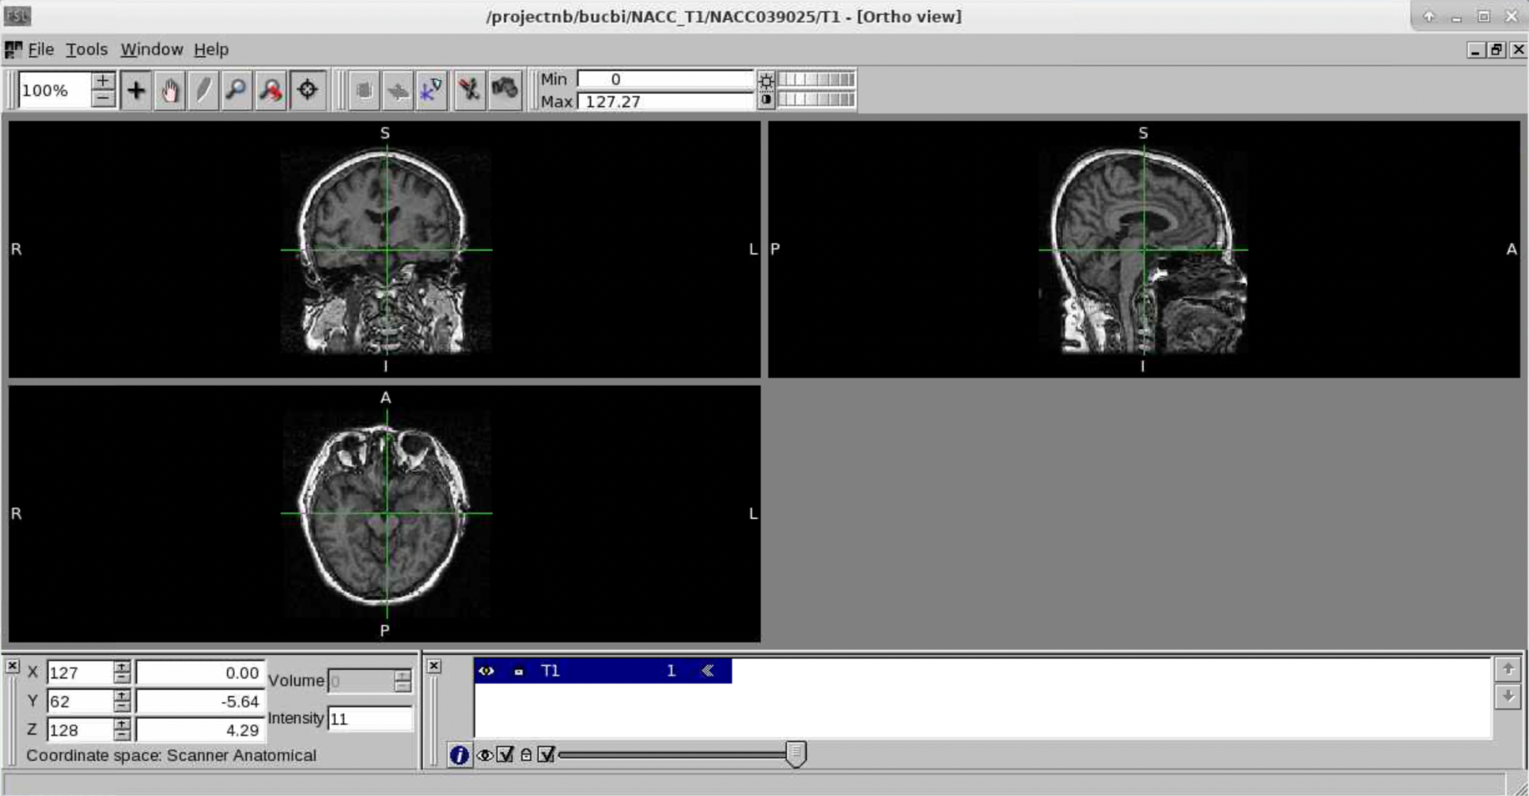
PREPROCESSING STEPS
BRAIN WITH SKULL

Slide 4
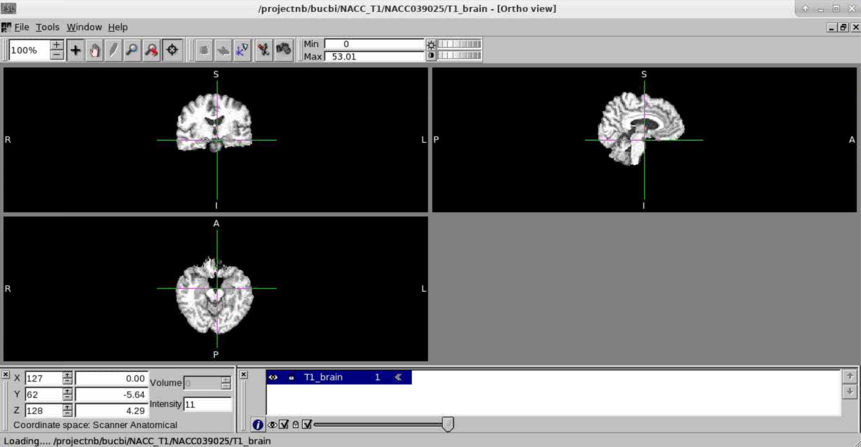
SKULL STRIPPED BRAIN

Slide 5
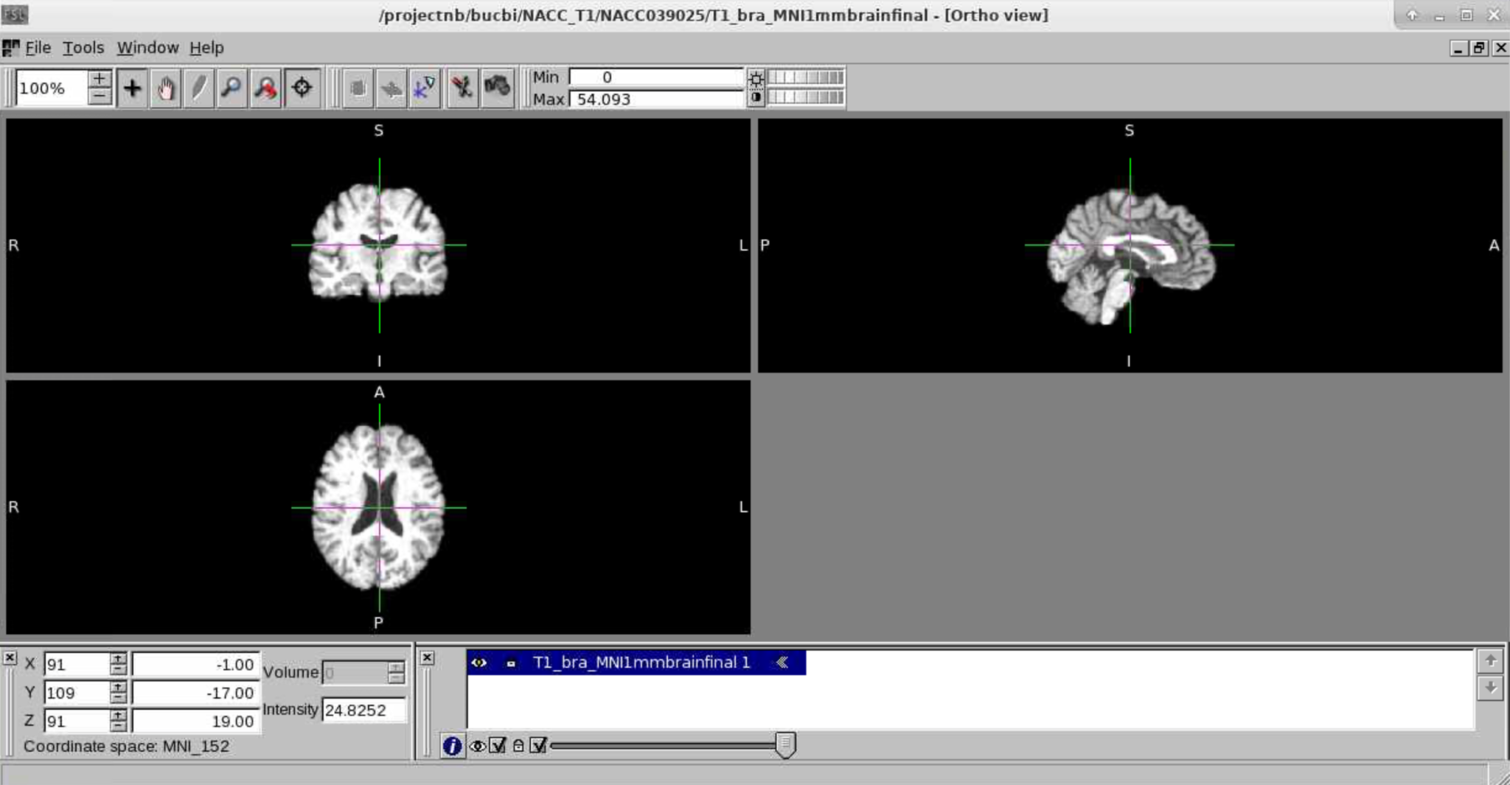
BRAIN WITH LINEAR REGISTRATION

Slide 6
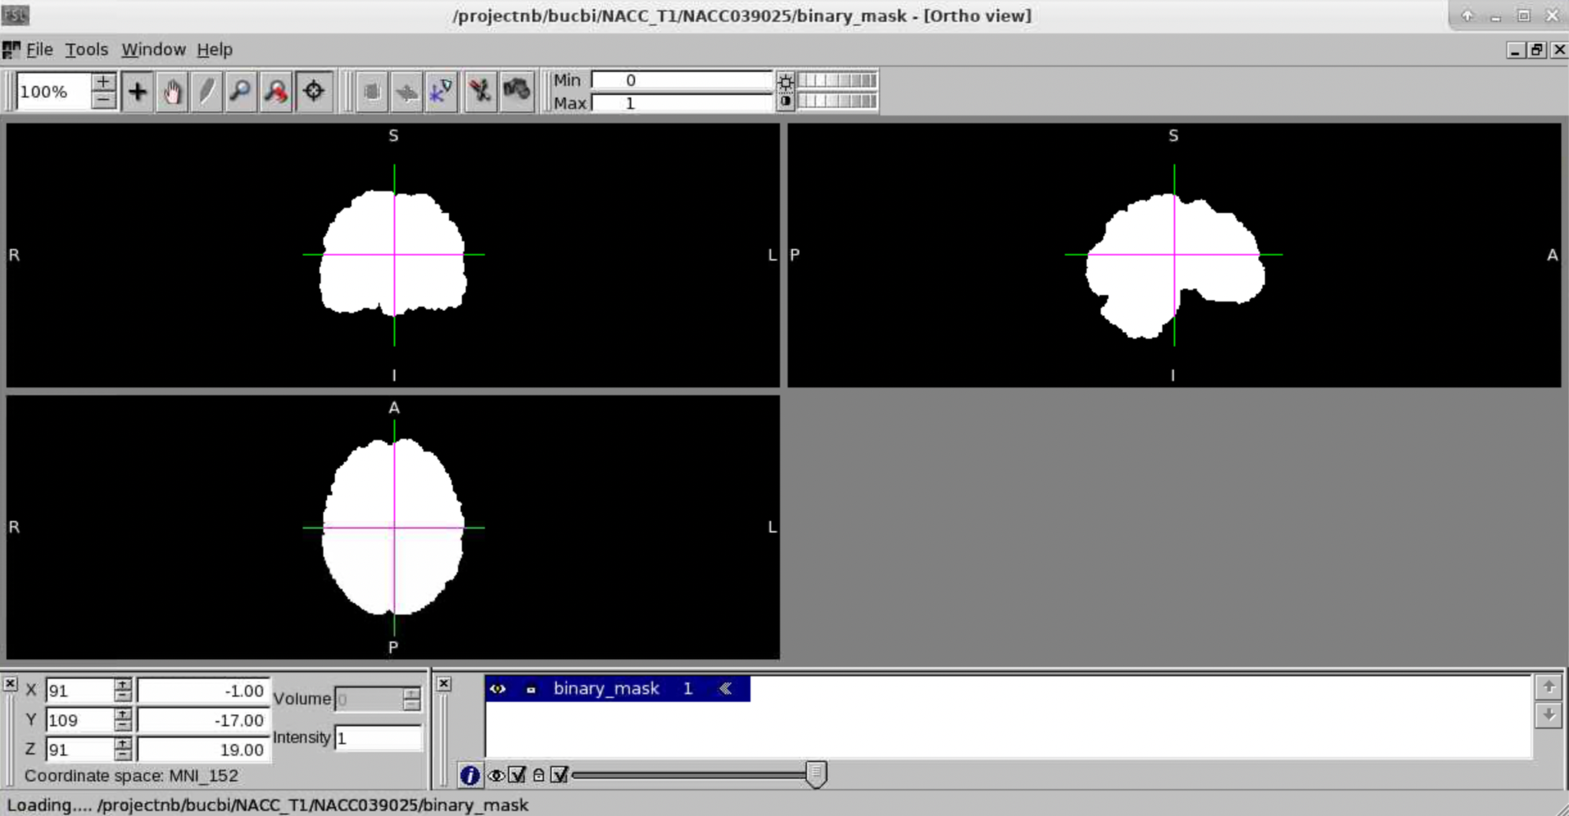
BINARY MASK

Slide 7
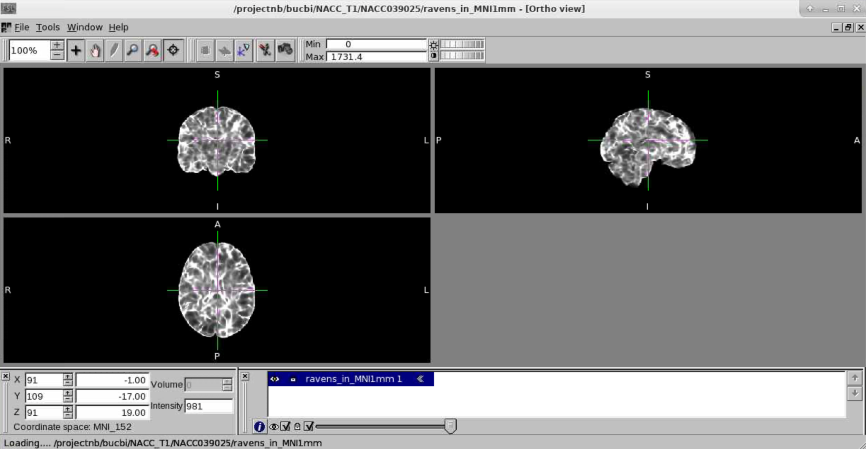
RAVENS MAP

Slide 8
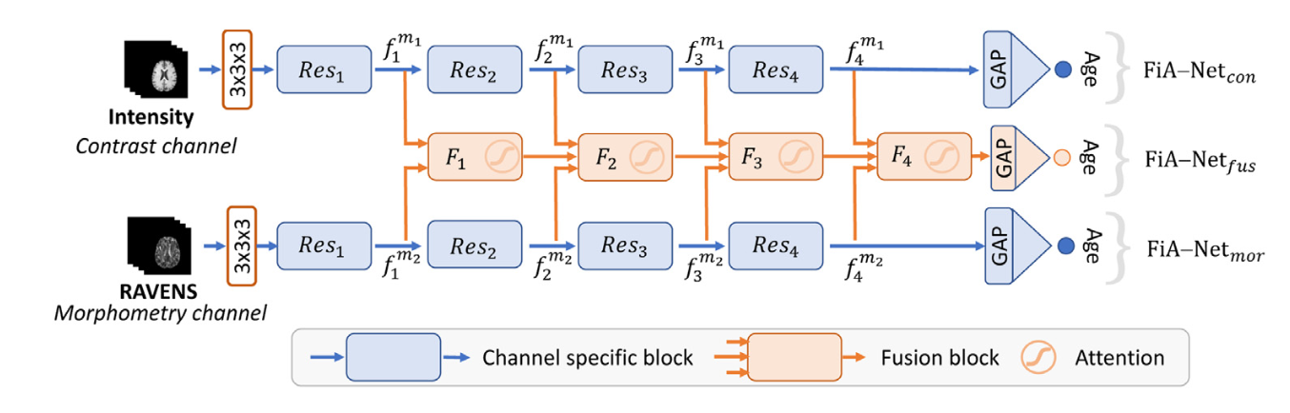
ARCHITECTURE-FIANET
Paper Link: https://www.sciencedirect.com/science/article/pii/S1361841521001377

Slide 9
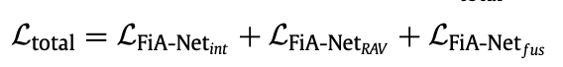
TRAINING SPECIFICATIONS
Learning Rate: 0.001
Optimizer: Adam
Epochs: 100
Batch Size: 1
Loss Function(MAE):
Scripts:
Dataloader: dataset.py(Attached)
Training: TrainingReg.py(Attached)

Slide 10
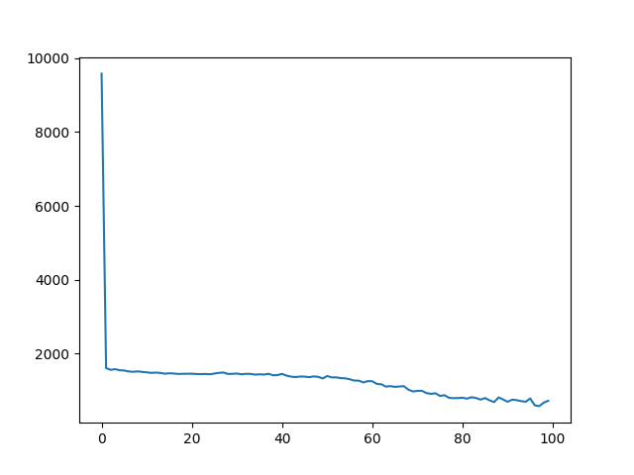
RESULTS
MODEL 1(NACC_T1)
Model: /projectnb/bucbi/Kathakoli/model1.pth
LOSS PLOT

Slide 11
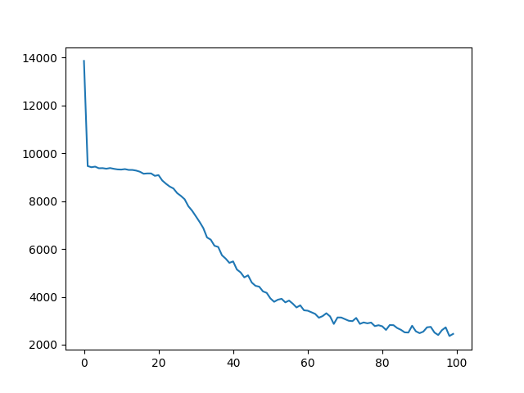
MODEL 2(Gulf war)
Model: /projectnb/bucbi/Kathakoli/model2.pth
LOSS PLOT

Slide 12
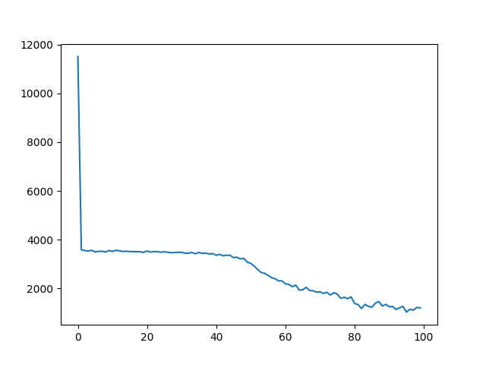
MODEL 3(UMass_T1)
Model: /projectnb/bucbi/Kathakoli/model4.pth
LOSS PLOT

Slide 13
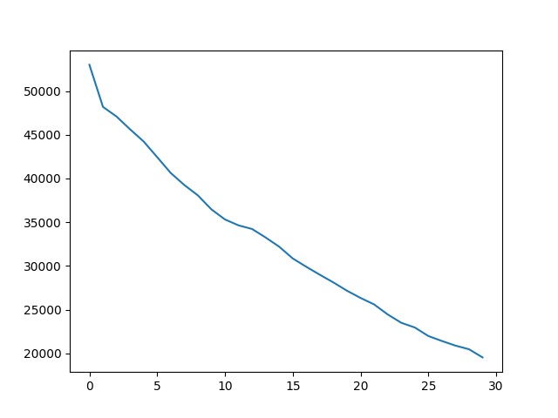
MODEL FINAL(GW, HCP,ADNI,NACC,UMass)
Model: /projectnb/bucbi/Kathakoli/modelfinal.pth
LOSS PLOT

Slide 14
CHALLENGES
The data we currently have is restricted age group data. The data they used had all possible patients ages from 0-97 years.
They have used N4 bias correction and FOV normalisation. Doing the same might improve our model performance.
FiANet uses 64,64,64 image so our image is resized to that. That might have resulted in some data loss. Cropping ROI might help in the process.
They had around 11000 training data and could perform good performance with 0.0001 LR and 25 epochs. Our data has only 4000 training points with GW patients. The learning rate was hence kept 0.001 ad the experiment was performed for more number of epochs.
The data is biased more to higher aged people including 100 years of age.
Our data is taken from different experiments, they had consistent data from the same setup.

Slide 15
WORK TO BE DONE
Train a final model with UMass, NACC, ADNI, HCP.(Monday)
Use a LR scheduler to choose the best LR throughout.
Use only fusion channel for the loss and not the summation of individual outputs and fusion output.
Once, the loss is significantly less while training , use cross-validation and CS for evaluation.
Segment the brain parts and train the same model for region wise analysis.

